Slide 1
Ad Click DataSet
Akshay L
Kailas D
Vivek S.
Notes:
<number>

Slide 2
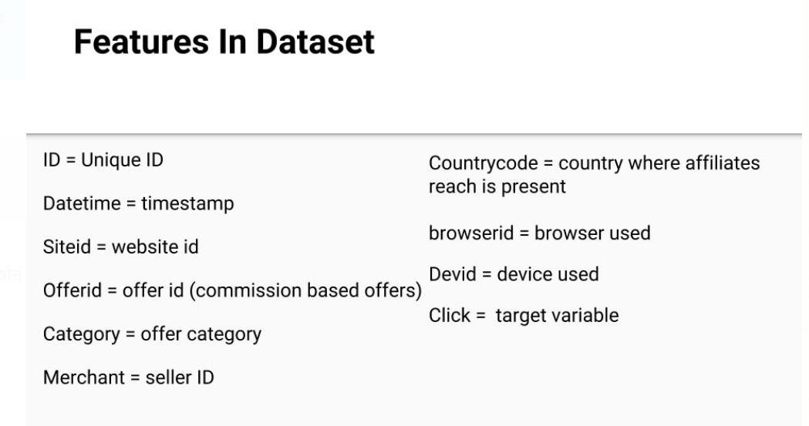

Slide 3
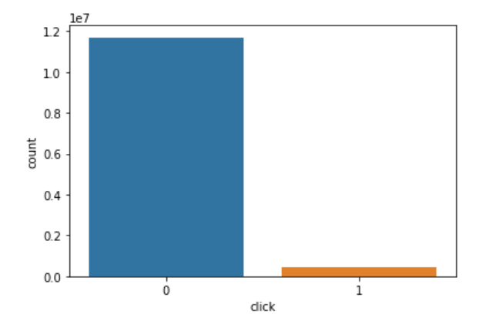
Problems with the data set
HUGE VOLUME OF DATA
IMBALANCED DATASET
MISSING VALUES
ALL CATEGORICAL FEATURES
CATEGORICAL FEATURES WITH HIGH CARDINALITY
ANONYMIZED DATASET

Slide 4
Solution to Problems
1
UNDERSAMPLING
2
IMPUTING MISSING VALUES.
3
ENCODING OF CATEGORICAL VARIABLES
4
CHOOSING APPROPRIATE MODEL

Slide 5
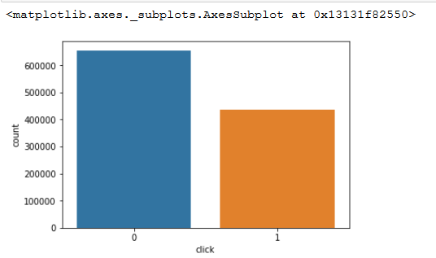
Undersampling
Then, Random under sampling – for majority class only.
Minority class stays untouched.
1. Remove rows with any missing data for Majority Classes.

Slide 6
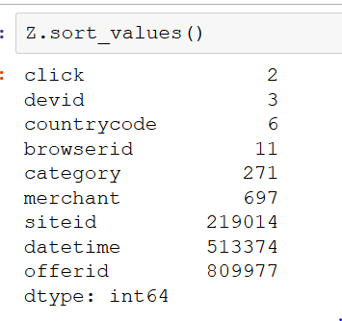
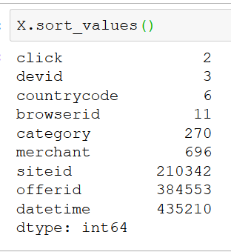
Categorical features unique values – Before & After
BEFORE:
AFTER :

Slide 7
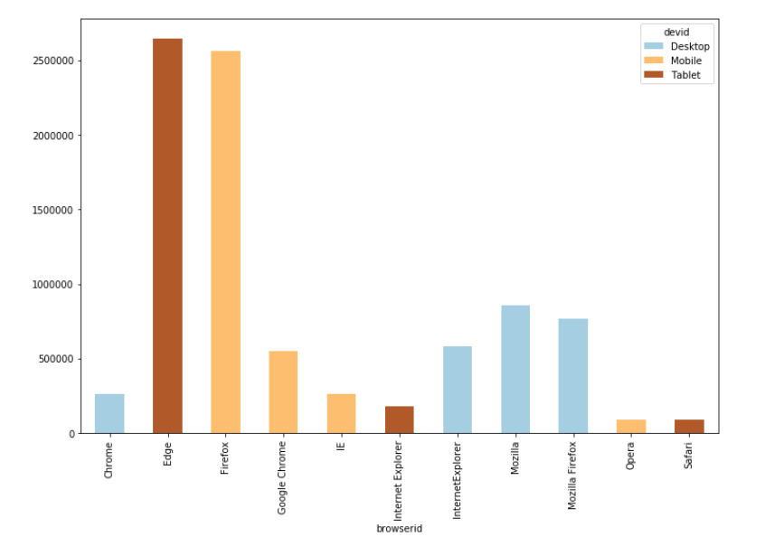
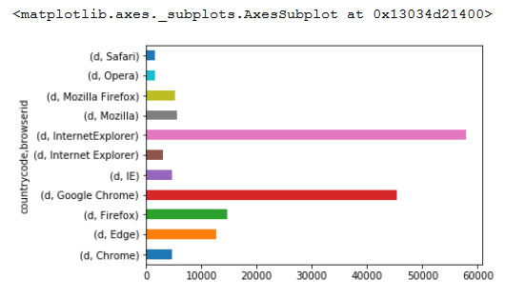
Imputing Missing Values
Browser – Based on Country
Device - Based on Browser
Site – Forward Filling

Slide 8
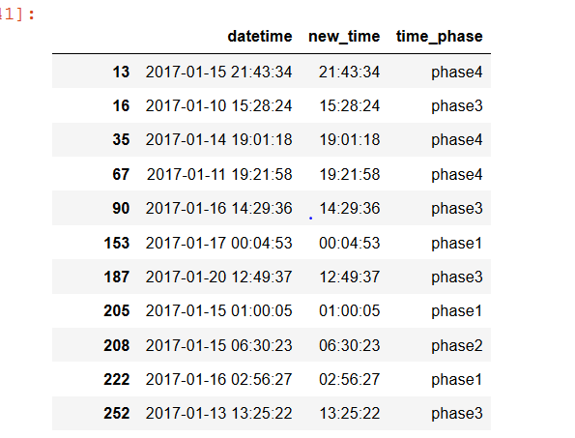
Feature Engineering – Extracting time

Slide 9
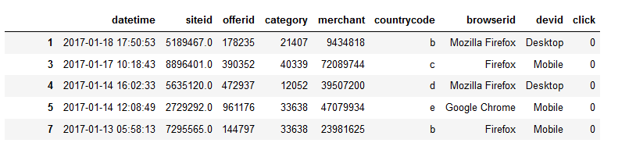
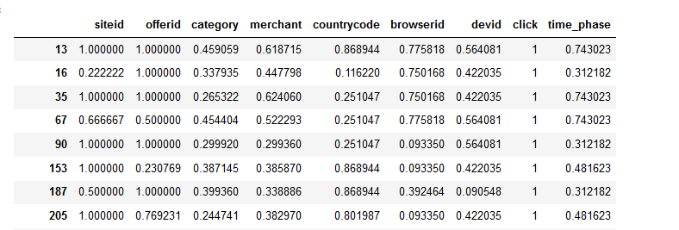
Mean Encoding
Solution to Data having categorical features with High Cardinality

Slide 10
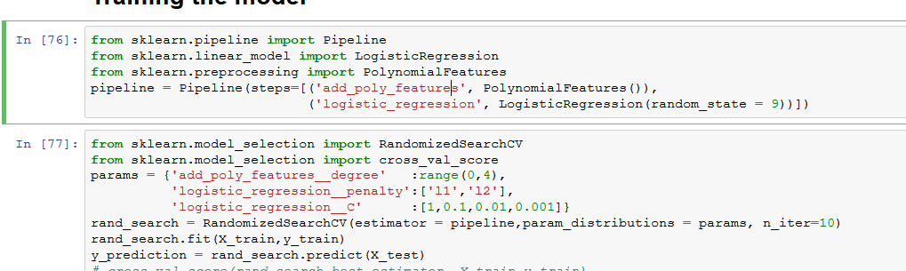
Logistic Regression – To Predict the Probability of Outcome
Apply Polynomial features
Use logistic regression with L1 and L2 penalty
Try different combination using RandomSearchCV

Slide 11
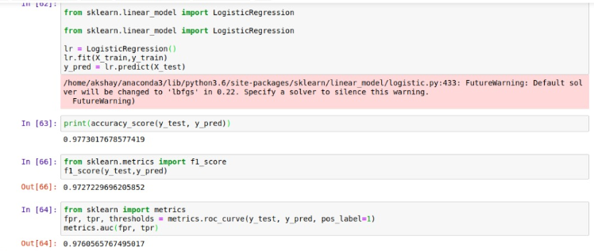
LR - Evaluation Metrics

Slide 12
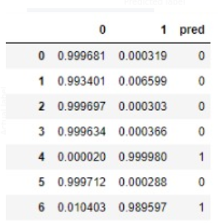
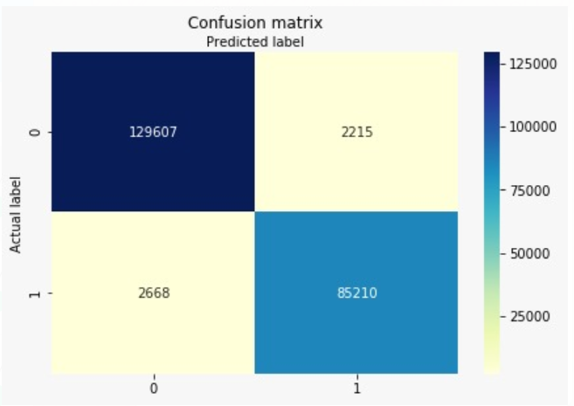
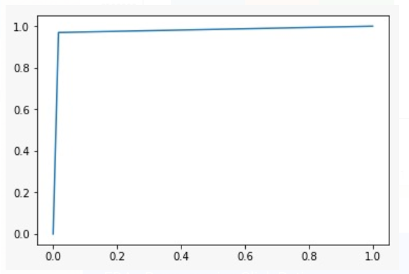
LR - Evaluation Metrics
1
2
3

Slide 13
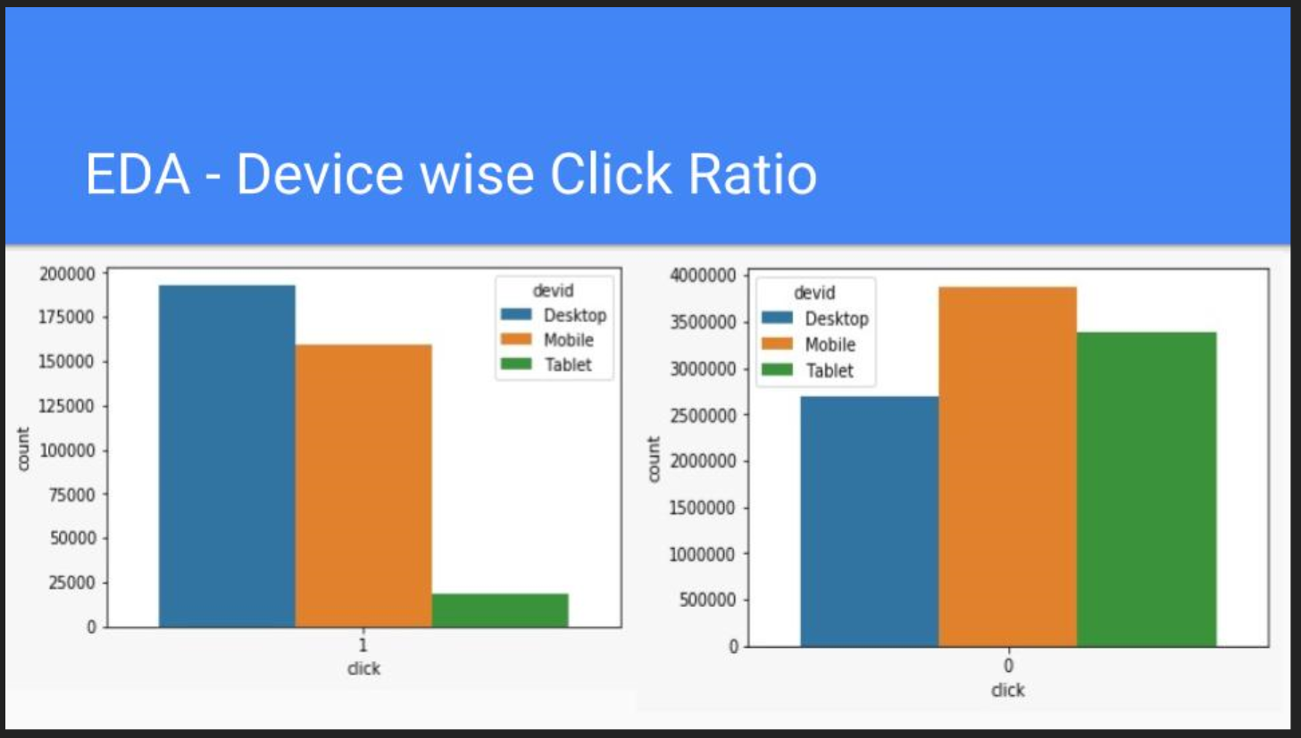

Slide 14
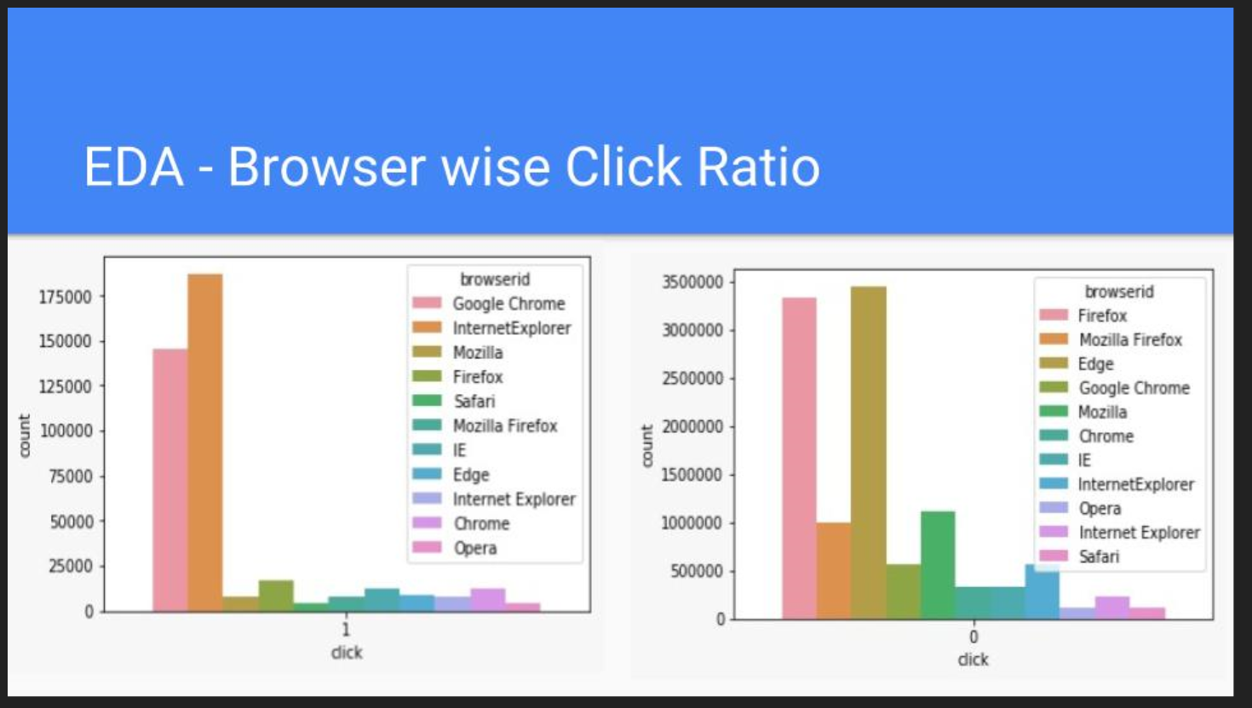

Slide 15
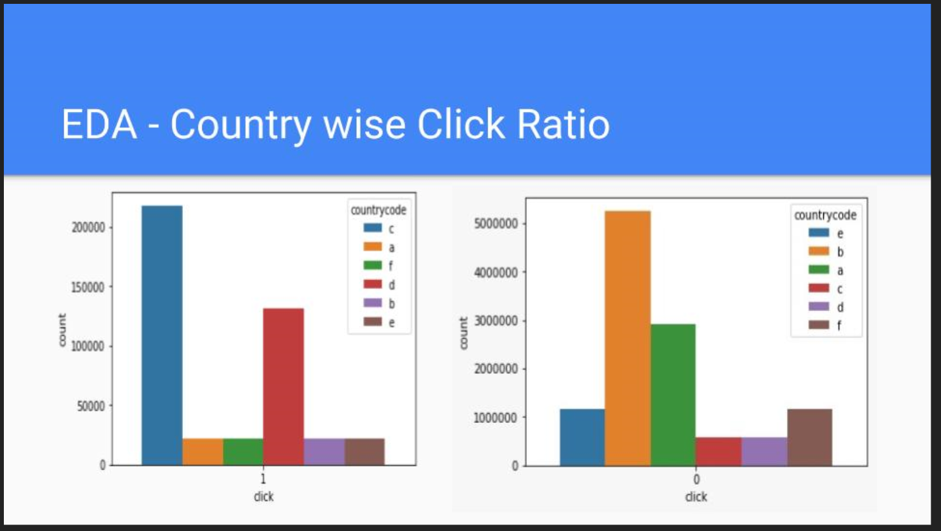

Slide 16
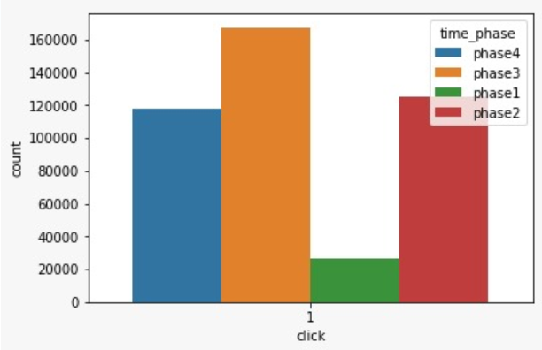
Phase wise clicks

